Slide 1
Dušana Findeisen, Slovenian Third Age University
Concepts Underpinning the LearnersMot2 Project
Ljubljana, Joint Staff Training
May, 2022

Slide 2
Intro People with poor literacy skills+ fewer possibilities in all areas of life= victims/sanitary crisis: Cannot counter harmful impact / personal, family, social risks factors’ interaction No good or improvised teachers- children early leavers from school and training

Slide 3
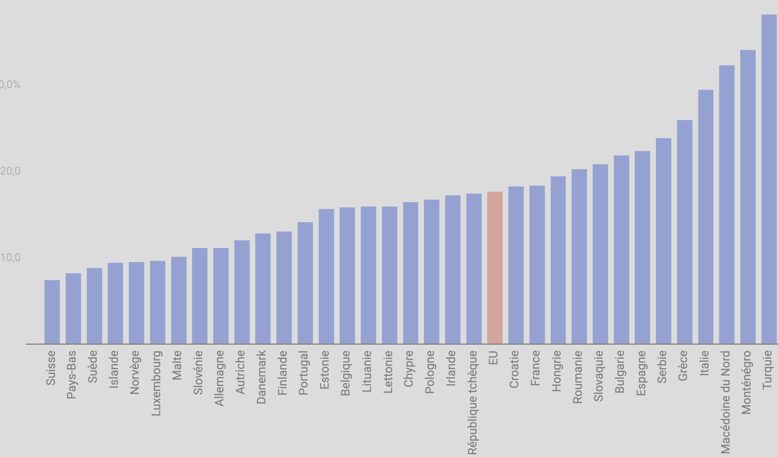

Slide 4
EARLY LEAVERS HINDER ECONOMIC AND SOCIAL DEVELOPMENT, EMPLOYMENT. POVERTY AND EXCLUSION ARE INCREASED EARLY LEAVERS! IF THEIR FAMILIES ARE FUNCTIONALLY ILLITERATE IF THEIR SOCIAL HABITUS IS NOT ENCOURAGEING. EX. “MY FATHER WAS AN ALCHOLIC, I WAS NOT LOVED, I MET FRIENDS, BELONGED, BREACHED THE LAW… BELIEVED THAT IMMIGRANTS WERE BAD, WAS EMPRISONED…GOT EMPLOYED, I SAW IMMIGRANTS WERE NICE PEOPLE”

Slide 5
3 questions: (1) How do literacy skills impact older workers’ working and their everyday life? (2) How can be the essential basic skills developed in everyday life and at work? (3) How can literacy programmes change older adults’ engagement with further learning

Slide 6
Literacy programmes? enhance literacy and numeracy relationships with reading writing, counting as well as communication+ relationships, motivation, cultural skills, etc.

Slide 7
About communication and relationships Most communication is seemgly ordinar ( e.g. making a conversation with a fruit seller, deciding where to eat with a friend) But! Everyday communication =a place where most relational and life matters take place. Our educational programmes should be written in a conversational tone because people over 45+ come from different backgorunds. Topics in communication come together and are interconnected.

Slide 8
Relationships impact communication and communication impacts relationships. Relationships are developed, maintained and modified through communication. Culture and society are created and performed through relationships and other significant people. Our understanding of the world has been formed and influenced by relationships Family, groups, work place can be understood not as structures but as an enactment of relational communication.

Slide 9
Motivating learners - crucial moments -when they resist to enrol I -they are ready to quit at any moment - motivation maintained! -when learning becomes more demanding, -when they have to cope with difficult life events, -when they do not like other learners

Slide 10
What should literacy teachers do: learn to be flexible! start by what learners know, address higher socio-psychological needs improve learners’ communication skills trigger learning through uthentic everyday situations!

Slide 11
Learners need to be continuously motivated for staying in education for their own benefit, the benefit of the companies and indeed entire community.

Slide 12
Low functional literacy is a by-product of development
Low educated and low skilled workers -like everybody- need to cope with -the changing world -declining division of work in companies -companies’ service orientation -more composite skills required from each worker.

Slide 13
Which skills/competencies/proficiency skills? Basic skills i.e. listening, reading, writing, communication and cognitive skills, cultural skills, social skills, digital skills and numeracy. Actually, there is no literacy without basic skills. In literacy programmes they cannot be dealt with separately but rather jointly, several at a time.

Slide 14
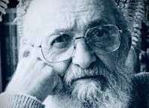
Functional literacy definitions Paolo Freire (1973) : functional literacy = a process towards the quality consciousness expressed through language and action. Freire (1972): learners should be helped to overcome their passive understanding and develop an increasing critical understanding of their reality. How? This can be be achieved through an active dialogical and critical pedagogy. Conscientization! Change of attitudes, perception or beliefs.
in other words, individuals must not accept that social reality cannot be questioned and changed. Critical understanding of situations leads to critical action (Freire, 1972)

Slide 15
How one lands up in situation of functional illiteracy Persons in this situation did go to school, wanted to learn, but nobody really taught them how to learn and “significant adults” did not respect them nor their learning. Therefore, their bad school memories hinder their learning sometimes for a life time.

Slide 16
Social unfairness on different levels, (poor economic level, poor socio-cultural level, stigma, etc.) strengthen the situation of functional illiteracy of individuals. Living on social allowance, narrow socio- cultural habitus, and stigma may contribute to adults’’ finding themselves in situation of functional illiteracy. In sociology, habitus encompasses socially developed habits, skills and dispositions. It is a combination of group culture and personal history that shape body and mind. (Pierre Bourdieu)

Slide 17
Life long skills acquisition and skills loss is a highly individual phenomenon. Skills may improve up to early middle-age. They reach a plateau in the middle of life. Increased literacy and numeracy skills ?? a result of worker’s improving skills in employment. The down-slope of skills in older age, is likely to be related to the ageing process, but it may demonstrate a reduction in the use of those skills as well. (David Mallows and Jennifer Litster, 2016)

Slide 18
Alleviating the problem of functional illiteracy of low educated and low skilled labour force could offer benefits to all: individuals, their families, companies and entire communties.

Slide 19
Theories behind a stronger foundation in educational theories is needed to design, deliver and evaluate educational programmes Due to its social transformative role, education of learners in situation of functional illiteracy should never be understood as simple transmission of knowledge, rather as a collective construction of knowledge.

Slide 20
Cognitive learning theory underlines the importance of personal agency as well as social and environmental variables to shape appropriate behaviour and to build up both content, knowledge and underdeveloped self-regulatory skills. Constructivism Experiential learning as well as inquiry-based and problem-based learning approaches Lev Vygotsky viewed learning and development as a social process. Learners grow into the intellectual life of those around them. Learning is a process in which learners gradually “take for themselves knowledge and skills they developed in their interaction with others and with cultural tools.”

Slide 21
What is learning? Learning is the process towards a relatively stable change in thinking, doing, attitude, behaving in general. For learning to exist there should be a noticeable or measurable change produced. It best occurs when a person uses his or her cognitive abilities, body, emotions and senses, when the person is exposed to the impact of a learning group and a variety of » cultural tools«.

Slide 22
Literacy programmes need to broaden the learners’ cultural tools: language, calendars, graphs, alphabet, verbal paradigms, organisation of forms to be filled in (first name, last name, date of birth, organization of letters, texts, etc. ), computer applications, =systems that take off the burden of constant thinking….and taking decisions. Low educated and low skilled learners need to apply skills, carry out a task and then reflect on it in an abstract way. This is how they learn.

Slide 23
Adult educators should have the ability to establish a critical distance towards the contents and the elements of knowledge to be taught. They should create learning situations. Not all situations have the potential of learning

Slide 24
How to approach learners in situation of functional illiteracy The method of choice is “biography” or life history -not unfamiliar to professional teaching. Connecting learners’ learning with everyday situations is another essential approach to reach out to learners in situation of functional illiteracy. Learning will be connected with learners’ every day or daily or routine life or work situations. Everyday life = routine, natural, habitual, or normal and is important in literacy programmes. Situations adults face in their everyday life may have similarities but they should be analysed with each and for each single learner.

Slide 25
EX: Identifying and observing everyday life situations As to integrate mathematics into learners’ everyday life, programme developers and educators should observe their life: cooking, repairing, setting table-there is a possibility to count pieces of dishes and cutlery for each person at table, or the number of guests is being counted and then the entire number of dishes, cutlery etc.). It is indispensable that educator identifies situations having potential for stimulating learning mathematics.. (Peter-Koop/ Grüßing, 2007).

