Slide 1
Bodily/kinesthetic intelligence module
Intergenerational Sport Solutions for Healthy Ageing

Slide 2
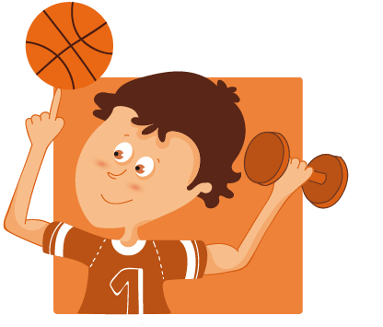
Bodily kinesthetic learning style or intelligence refers to a person's ability to process information physically through hand and body movement, control, and expression. It is also known as the physical learning style or tactile-kinesthetic learning style.

Slide 3
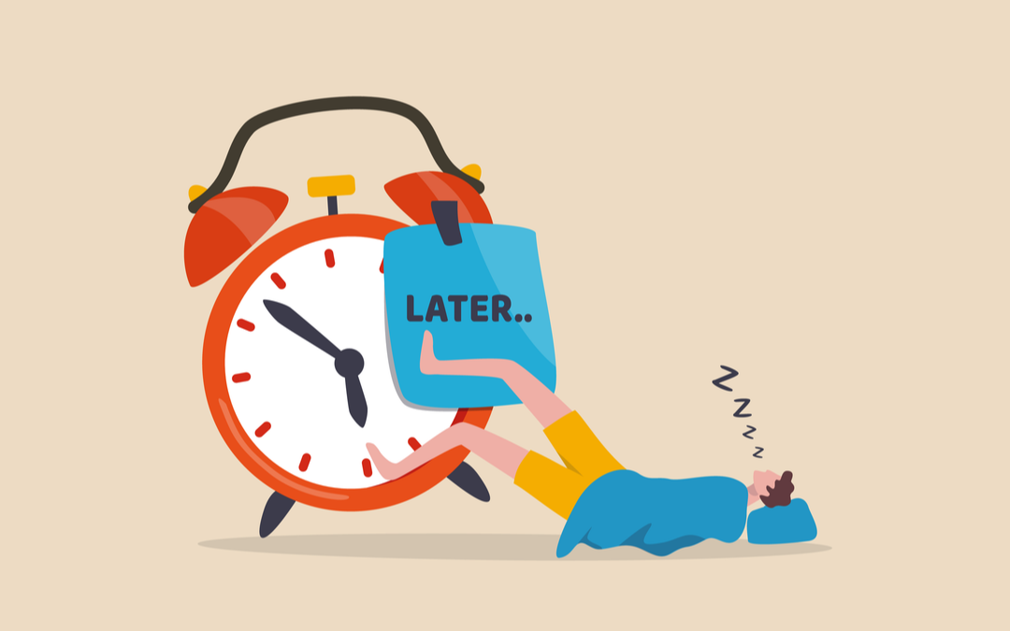
Overview
This module was created to provide trainees with practical examples of how to improve bodily kinaesthetic intelligence in adolescents and the elderly. The trainers will present BKI and its significance in active ageing and young well-being in this unit. The trainer will also go through all of the qualities that an exercise must have in order to activate the participants' BKI. The trainees will then participate in a practical activity that will serve as a model for building future BKI programs. The first activity focuses on increasing attentiveness and critical thinking skills. The trainees' second activity, on the other hand, will be more focused on the development of communication and coordination skills.

Slide 4
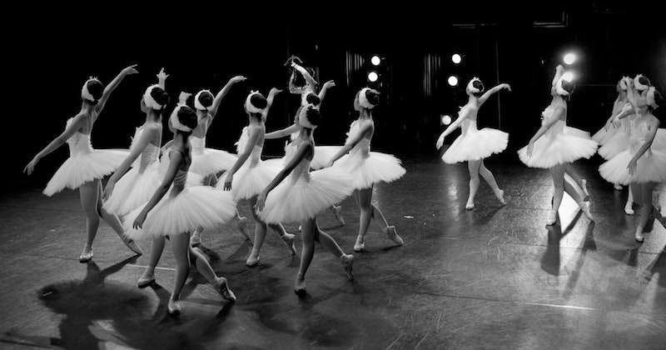
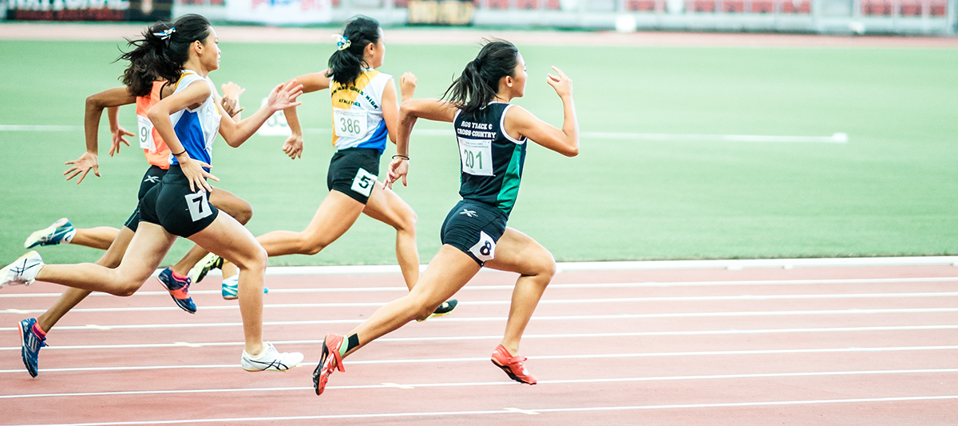
The ability to control items and apply a range of physical talents is referred to as bodily kinesthetic intelligence. This intelligence also includes a sense of time as well as the mastery of abilities achieved via mind–body integration. Athletes, dancers, surgeons, and others who work with their hands have highly developed physical kinesthetic intelligence.
Sport activities are thought to generate an intergenerational interaction zone in the Funmilies initiative, which is not confined to physical exercise with physical health advantages only. They are also said to have the ability to build relationships and have a transforming effect on society. The outcomes of intergenerational programs and scientific researchers have proven that intergenerational activities help both the old and the youth, which has been the subject of research and analysis in recent decades.

Slide 5
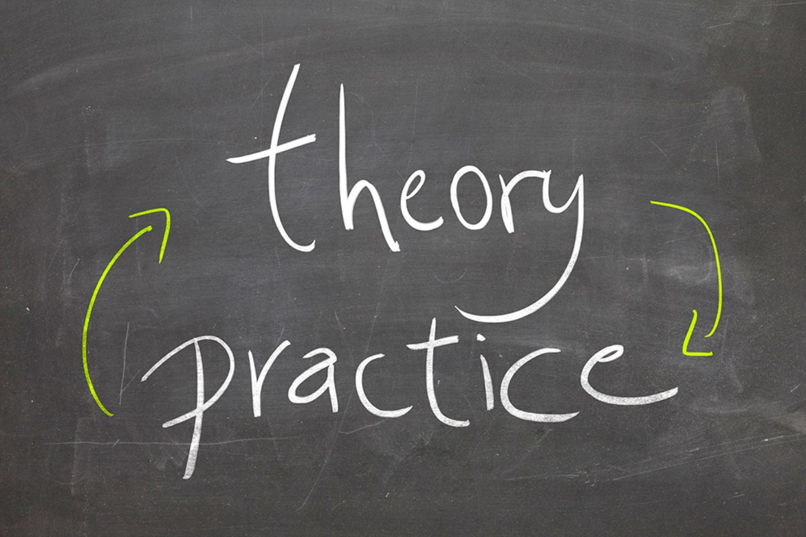
Practical part
The following activities put the concept of bodily intelligence into practice and can teach people how to use their body as a learning tool as well as enhance the intergenerational activities which help both the old and the young.

Slide 6
Activity 1: Make the story
For the the importance of Bodily kinaesthetic intelligence unit the group will participate in an activity called “Make the story”. They will form a line and one person at a time will be stepping forward to say a word of a story, then step back in the line. Another person will carry on the story by stepping forward and afterwards stepping back in line. The story will be created like that until every member of the group has participated. The activity will continue until the story naturally ends.
Objectives:
Increased attention span
Increased concentration
Better communication skills
Better analytical thinking

Slide 7
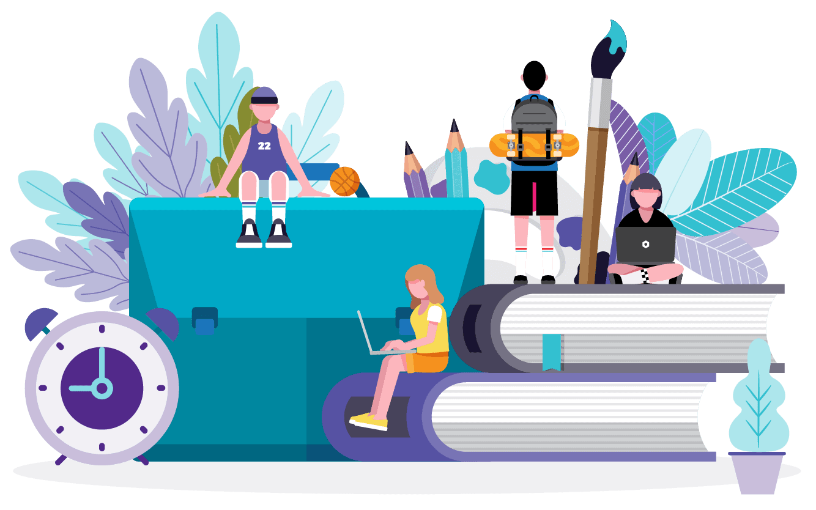
N° of People: It will depend on the number of participants in the event, but 5-10 people per team would be best for the facilitators.
Sub-module objectives: This unit would aim to enhance the attentiveness of the group and relate a mental exercise with a physical one.
Time: Half an hour should be enough with a possible extension of about 5-10 mins.
Materials needed: Paper, scissors, makers, tape, stickers, sticky notes

Slide 8
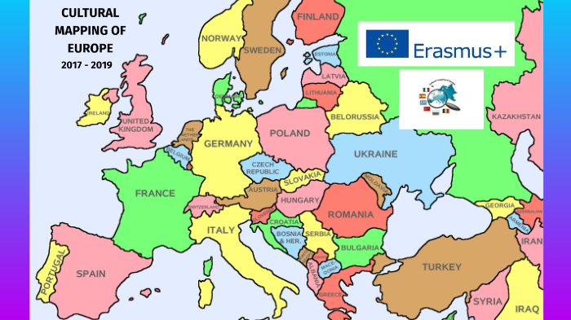
Activity 2: Find me on the map
Delegates should form a big board and assign persons to certain sections of the board. The board will be displayed as a cultural map with information on the cultures, traditions, and beliefs of a certain nation. Every 2 minutes, the trainer will be reading a line about a different culture, and the participants must position themselves correctly. The exercise "Find me on the map" combines the concepts of physical intelligence and intercultural communication. The aim for participants will be to learn about other cultures via physical activities and practical knowledge.
Objectives:
Awareness of the cultural differences
Cultural education
Improvement of the logical thinking
Improved communication skills

Slide 9
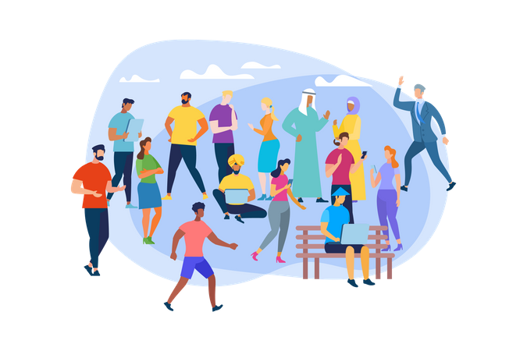
N° of People: All of the people shall take place in this activity
Sub-module objectives: This unit would aim at providing understanding of the different cultural values.
Materials needed: Colorful pens, markers, highlighters, paper
Time: 30 mins to 1 hour

Slide 10
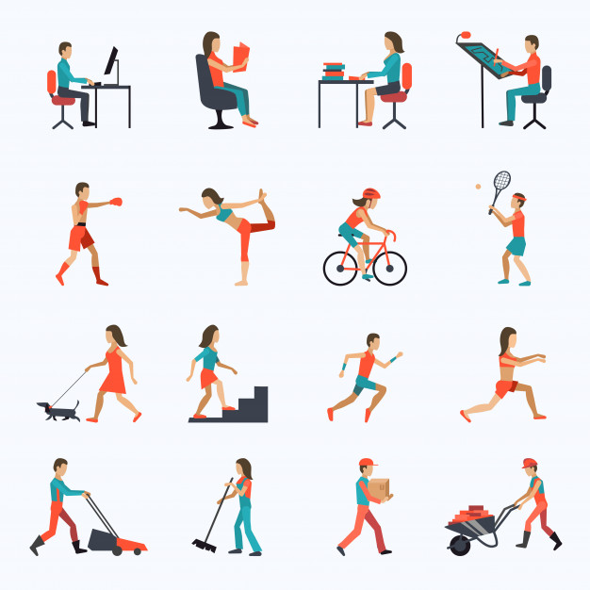
Physical activity promotes high productivity!
As an alternative activity the trainer may encourage the participants to share their experiences as well as the activities that they usually practice for improving BKI.

