Slide 1
Funmilies WP3
Education Through Sports

Slide 2
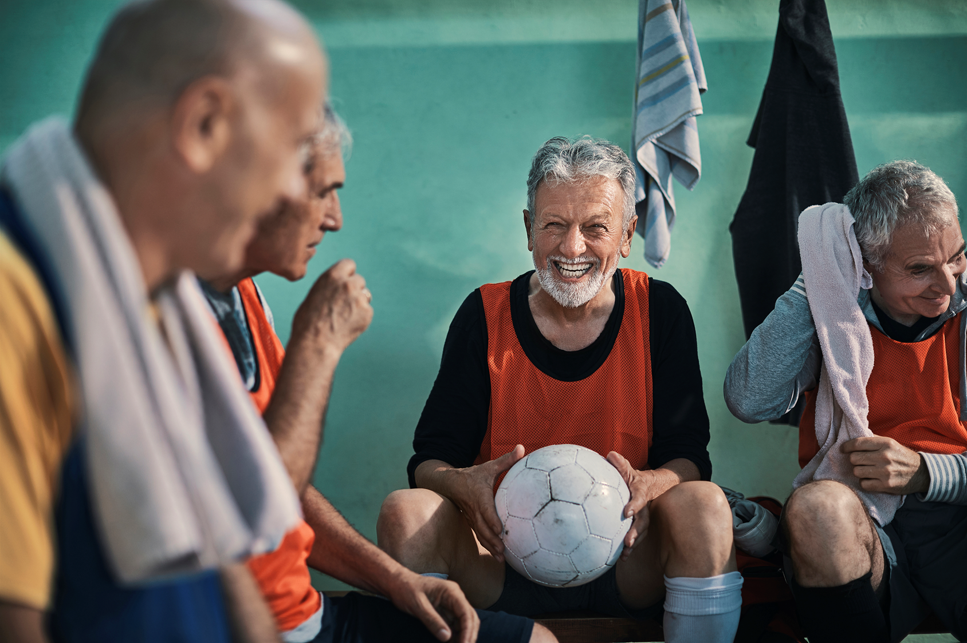
Agenda
Introduction
Education for/by/through Sport
Education Through Sport in depth
A How To Guide
Design your own exercise

Slide 3
Introduction to the concept
Education Through Sport (ETS) is a non-formal educational approach that uses sport and physical activity to development key competences of individuals and groups. By using the ETS methodology, you use sport exclusively as an educational tool. Why is ETS important?
To make good use of the non sport components of the activities (education, mentorship, skills, training, reflection, intervention, etc.);
To be aware and use non formal education in planning and designing a learning process while using sport;
The educational objectives and the function of pursuing educational goal while using sport are crucial in the ETS methodology;
There are 3 types of learning drawing to different objectives to be distinguished Education FOR, BY and THROUGH SPORT.

Slide 4
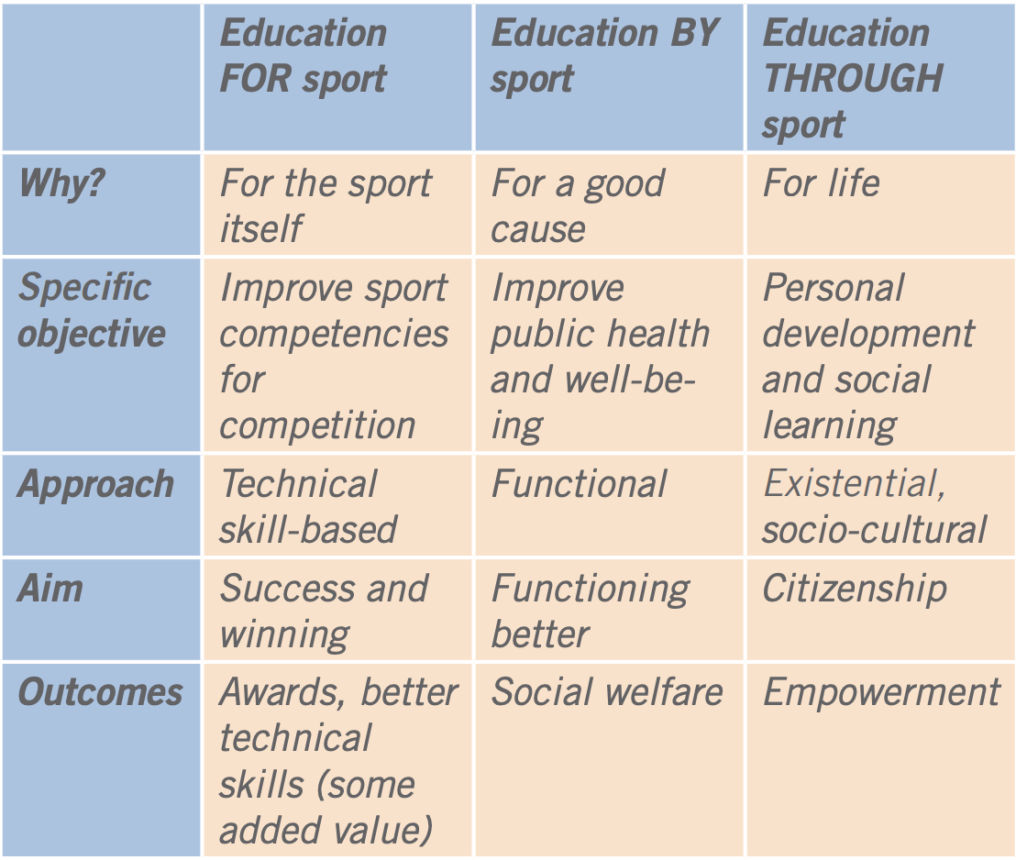
Education FOR/BY/THROUGH Sport
EFR: Many traditional sports clubs are mainly mobilised by sports performance goals as their priority. EBS: The concept of Education BY Sport is more complex process and includes specific objectives such as the aim to address health issues and wellbeing. ETS: It consists of adapting sport and physical activity exercises to the objectives of the planned learning project. More information HERE.

Slide 5
Sport and educational sector of ETS
Sport factor Researches have shown that sport and physical exercise have a variety of positive effects on health. Practicing physical activities on a regular basis helps reduce the likelihood of chronic and cardiovascular diseases, cancer or hypertension and addresses a number of psychological disorders. Furthermore, sport and physical activities have positive effects on depression, anxiety and self-esteem.
Educational factor Non-formal education – an integral part of the ETS methodology – uses a different approach from formal, textbook education when it comes to identifying the needs of learners. It allows individuals to identify their own needs and goals regarding the educational process. Feedback and reflection, on the new information and gained knowledge, are essential parts for the ETS methodology to ensure the learning outcomes.

Slide 6
HOW-TO
The main requirement is to build up an educational project, which is feasible: has realistic and attainable goals or outcomes defined thus has evaluable objectives. What do you want to achieve?

Slide 7
HOW-TO
The non-formal learning outcomes should be introduced in the design (e.g. through questions or an evaluation session) thus keeping focus on the social issues that the target groups are to be educated about: fairness, teambuilding, equality, discipline, inclusion, perseverance, respect or any other field you would like to address.
What is the social change you want to aim at?

Slide 8
HOW-TO
People can connect through sport on levels beyond just communication with words.
Sports can be used to strengthen the connection and communication between age groups of 25- and 65+: By using the ETS methodology, the different sport activities planned to bring together these two age groups, can really be designed to achieve greater awareness and connection, social inclusion as well as the promotion of a healthy mind and body regardless of age.

Slide 9
HOW-TO
Each exercise should be built up in a way that the participants connect on a non-verbal basis and the physical activity aims to raise awareness around the importance of social inclusion and connection between groups and individuals.

Slide 10
HOW-TO
After each ETS exercise a debriefing session should be introduced where the participants can share how they experienced the exercise, for example in a circle where everyone feels comfortable and able to share. You should use prompting questions like: How did you feel during the exercise? Do you feel connected to the youth or elderly person you moved with after this dance exercise? Would our society at large benefit from more intergenerational “workshops”? If yes, why? If not, why? Is it the responsibility of the governmental agencies to provide these opportunities to connect? Add any other questions that would be relevant to the topic of the activity.

Slide 11
A little more information for you as Trainer
To have an even better understanding of ETS, please read Annex 1. and you can find examples of exercises on the following links from other projects: https://www.moveandlearn.org/ https://sportlearning.eu/education-through-sport/ Adult Education Through Sport: https://www.youtube.com/watch?v=gkVuTYTY7Kk&list=PL-CQOPJ4emDLWcgWNCZgQbw9Q7kQW2SPq&index=9 Values education through sport UNESCO:
https://www.youtube.com/watch?v=K4mhtXPVAI0

Slide 12
Design your own intergenerational exercise
Main points to consider:
Set your educational objective or learning outcome (e.g. intergenerational understanding and empathy building)
Draw upon your professional experience within sports or other reliable sources
Select a sport or physical activity/activities to serve as a medium
What non formal educational tools will you use to convey the educational objective to the participants throughot the exercise?
Introduce a debrifing session (e.g. group discussion, questionnaire)

Slide 13
Thank you for your attention and we wish you the best of luck with your exercises!

