Slide 1
Funmilies
Intergenerational Sport Solutions for Healthy Ageing
Capacity building program for sports professionals
Module One: The Importance of intergenerational inclusion

Slide 2
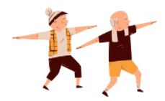
Learning objectives:
1) Increase the knowledge on the importance of intergenerational relations and inclusion
2) Develop the capacity to structure and design an intergenerational practice
3) Develop the capacity to activate and conduct a process of intergenerational inclusion

Slide 3
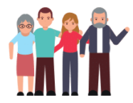
What trainees will learn at the end of the module:
a) The importance of the intergenerational relations;
b) The needs to be addressed in an intergenerational process;
c) How to activate a process of intergenerational inclusion.

Slide 4
The module is divided into three units:
(1) The importance of intergenerational inclusion
(2) Intergenerational practices
(3) Successful Intergenerational activities

Slide 5
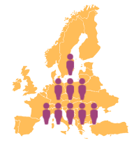
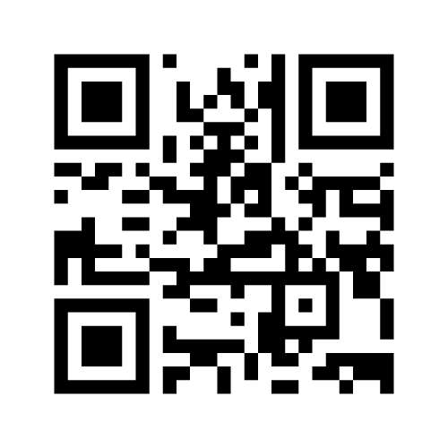
(1)The importance of intergenerational inclusion
How is European population changing?

Slide 6
By 2060, European population aged 65 years and above will be 29.5%

Slide 7
The median age of the European population is 44 years and live births are decreasing

Slide 8
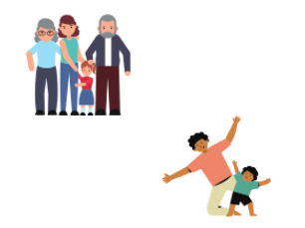
The change in the household composition
There is a shift from the traditional nuclear family with different generations living together to the contemporary households with an average number of 2.3 family members.
Older people reported that their satisfaction about life decreases with age (Eurostat, 2015), in particular single older people report to be less happy than those living in a household with two or more members.
This data suggests the necessity of promoting active ageing of older people and of promoting intergenerational inclusion since the intergenerational exchange is not favored anymore by families composition and proximity.

Slide 9
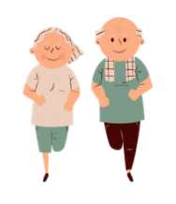
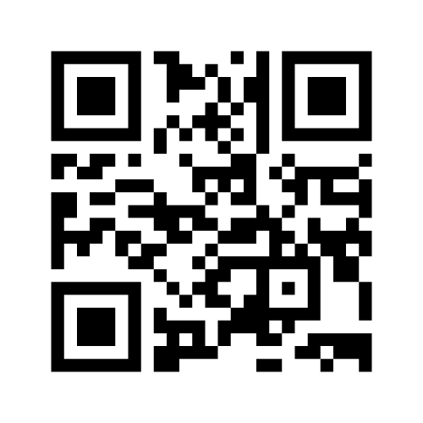
Older people in sport

Slide 10
World Café – discussing together
Three groups:
What is active ageing and how it can be achieved
What is social inclusion of older people can be achieved in practice
What is intergenerational inclusion and how can it be achieved through sport?

Slide 11
Active ageing

Slide 12
The four identified dimensions for active ageing are:
Employment
Participation in society
Independent, Healthy and Secure Living
Capacity and Enabling Environment for Active Ageing (UNECE, 2018).
According to the last report of 2018, the southern European countries are
those with the lowest AAI (UNECE, 2019).
The Index identifies as fundamental categories for active ageing: Physical
exercise; Lifelong learning; Mental wellbeing; Social connectedness.

Slide 13
Social inclusion of older people

Slide 14
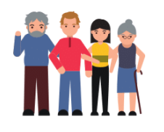
Intergenerational practice
“Intergenerational practice aims to bring people together in purposeful, mutually beneficial activities which promote greater understanding and respect between generations and contributes to building more cohesive communities. Intergenerational practice is inclusive, building on the positive resources that the younger and older have to offer each other and those around them” (Beth Johnson Foundation, 2011, p.4)
What is important is that through intergenerational practice, youth and older people mutually benefit from the exchange and are actively included in society, feeling valued, resourceful, part of a social group and respected.

Slide 15
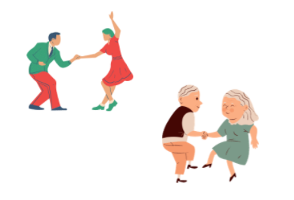
For intergenerational inclusion to happen, it is not only important to find physical places for inclusion, but to create spaces free of barriers that facilitate this mutual exchange.

Slide 16
(2) Intergenerational practices
https://www.youtube.com/watch?v=AfERQ-Riy2E

Slide 17
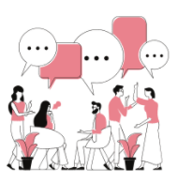
How did you feel about the video?
Jamboard

Slide 18
Benefit of intergenerational activities – overcoming stereotypes
For youth, to engage in an intergenerational activity, can increase their sense of stability, their social skills and help them in reducing social anxiety.
While elderly can benefit from it, feeling healthier, less lonely and more involved. Elderly can find in their relationship with youth a new meaning and direction in life and, in turn, youth also find meaning in learning from older people and in developing their emotional stability (Standford Centre of Longevity, 2016).
For both groups, to engage in an intergenerational activity contributes to higher levels of self-esteem (ECORYS, 2020).

Slide 19
Benefit of intergenerational sport activities

Slide 20
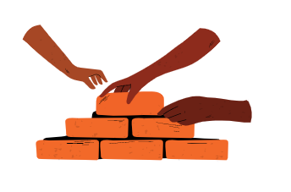
How to build youth-older people relationship?
Relation has to be prolonged in time
Choose a neutral space
Communication balanced
Match strenghts and needs
Build a bi-directional relationship - neither party is treated as stereotypically needy
Rights and duties are equally shared
Principle of reciprocity- mutual respect, learning, and understanding

Slide 21
Creating Links
Group A – Sport Activity
the organisers (2),
the older people (5),
the youth (5)
Group A – Recreational Activity
the organisers (3),
the older people (5),
the youth (5)

Slide 22
(3) Successful Intergenerational activities
It is important to co-create the activity with the participants to ensure its success but also their participation in the program
Constant feedback on the activities from the two age groups

Slide 23
Since the initial engagement is not straightforward, it is important to analyse also which can be common interests among the participants.
Involving families may be beneficial because older components of the families may increase the participation of youths in the program
Certain level of disclosure between the age groups it can be achieved through ice-breaking activities, or informal meetings before or after the activity

Slide 24
Lifelong Learning
Having FUN
Developing new skills

Slide 25
