Slide 1
Dušana Findeisen, Meta Kutin Slovenian Third Age University Raising Awareness, Expressing and Changing Perspectives DREAMLIKE NEIGHBOURHOOD Older people connect in their communities Age Platform, Brussels, on-line October, 2022

Slide 2
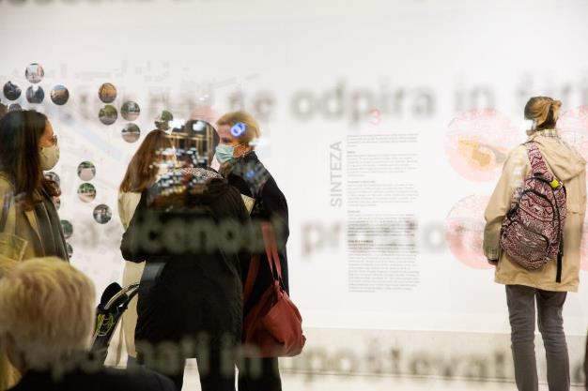
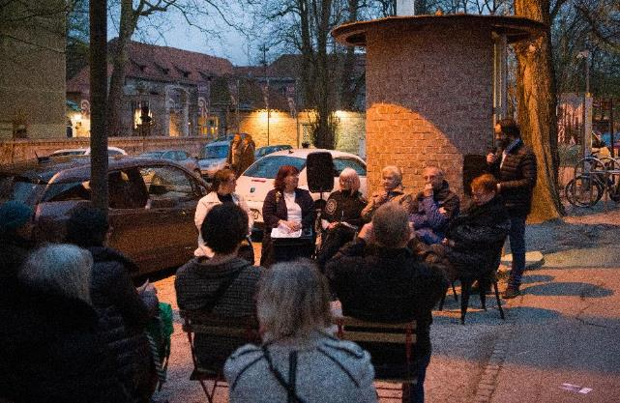
In Vienna, The Hague, Prague and Ljubljana events took place beyond the walls of organisations for/of older people: What for? > To connect “inactive” older people with the world of active people > To raise awareness about older people’s issues > To contribute to social fairness by changing perspectives
Photo: Kaja Brezočnik
Photo: Janez Marolt

Slide 3
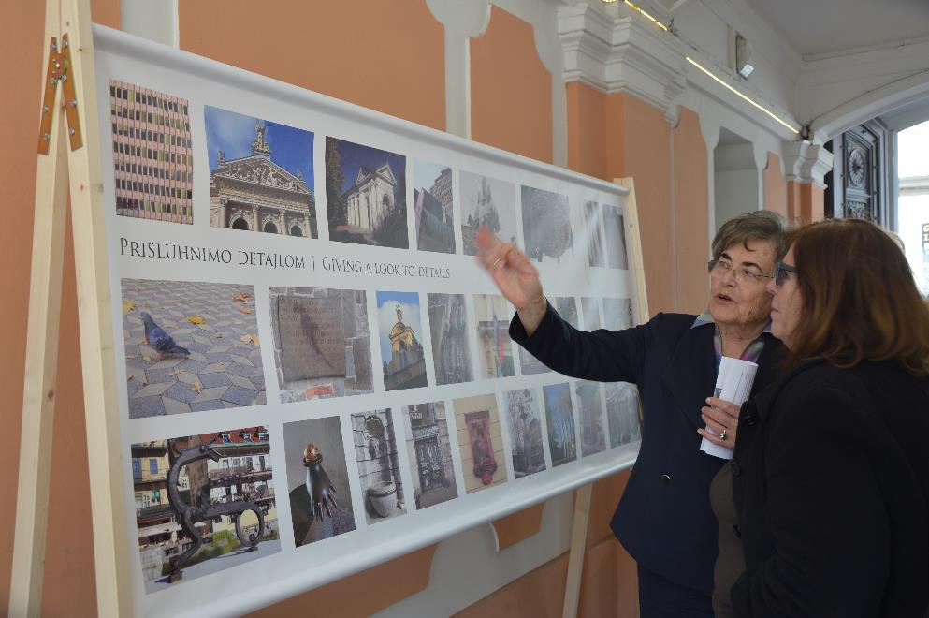
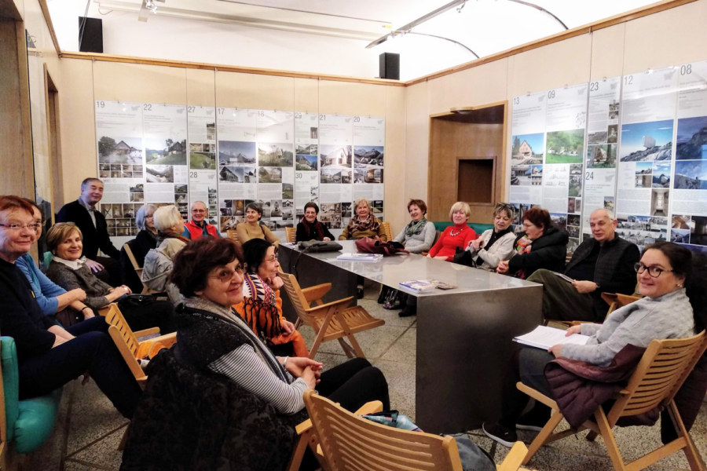
Raising awareness is an > ongoing, > carefully planned process, > a system of activities defending a cause by informing, educating etc.
Photo: U3A archive
Photo: U3A archive

Slide 4
What does raising awareness stand for? > Working on a cause - many people have to be aware of the problem. > In long lived society professionals etc. don’t know older people! Old age stereotypes, prejudices, older people aren’t their equals! > Older people have to pass on knowledge about themselves (abilities, needs, wishes, aspirations). > Facing Knowledge Deficit Disorder (communication theory from the 60’s) > Undertaking actions!

Slide 5
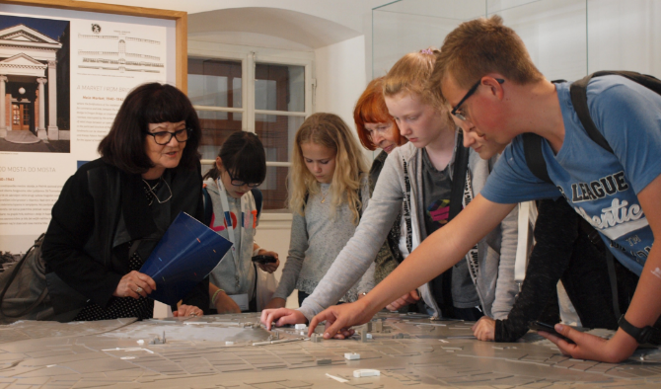
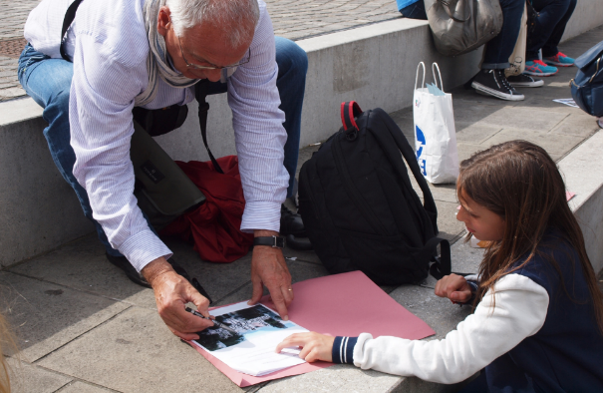
Photo: U3A archive
Photo: U3A archive
The cause of our project and activities are
> quality ageing, > connecting older people’s learning with using their knowledge, > contributive inclusiveness of older people, > social changes = greater social fairness.

Slide 6
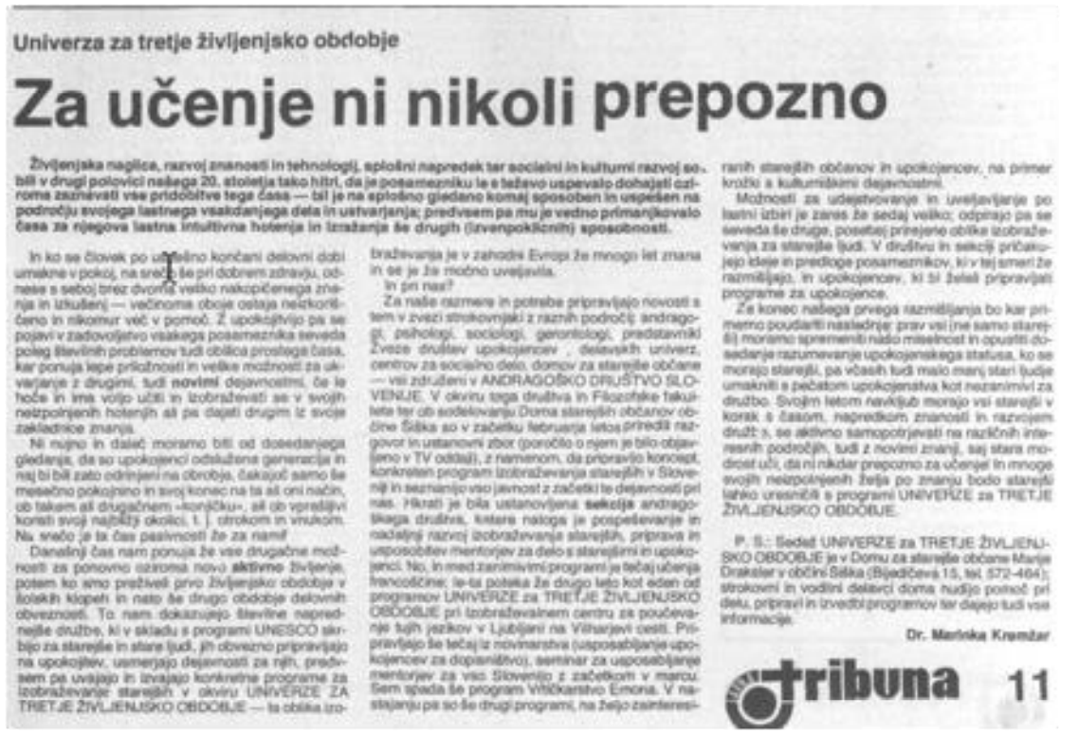
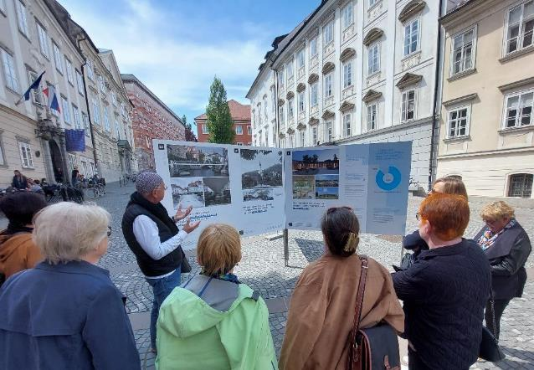
At Slovenian U3A there is a long tradition of: > studying the city, > education for local development, > socially engaged education + socially engaged arts.
Photo: U3A archive
Photo: U3A archive
1986:
Marinka Kremžar, It is never too late for learning, Tribuna, 1986.
2022:
students shearing knowledge about neighbourhood architecture and urban design.

Slide 7
BUT: In the Dreamlike Neighbourhood Project older students from Slovenian U3A shifted their focus from studying the city to studying themselves in the city City 65+: Between Retreat and Urbanity > Older people need to co-shape the city

Slide 8
Why retreat, why urbanity? > Retreat Older people‘s retreat may be manifested in different ways: - some go to the city at peak hours – to have an illusion of belonging, - some overtly fear joining crowds in the city so they do not go out easily, - some like observing life in the city (Carl Rogers: A way of being). > Urbanity Is related to a system of places, not only one´s flat: - urbanity is supported by everyday quality services, - by lively, not excluding! public spaces, - by linking older people´s present to the past and future of the city - by preserving and building the identity of the neighbourhood. Identity is essential for preserving older people´s bonds with the city.

Slide 9
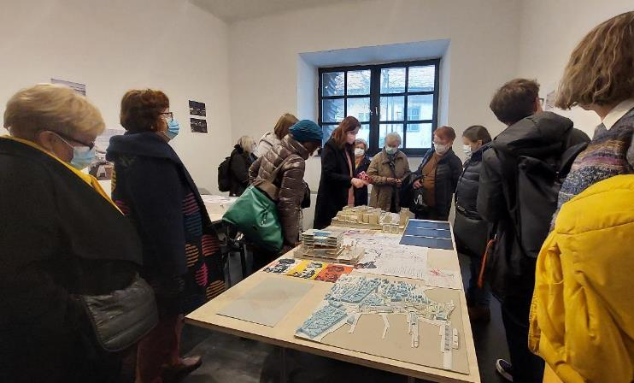
Our way to achieve urbanity: > Research in the Poljane area > Cooperation of U3A with Association of Architects of Ljubljana > Joining wider events: Month of Urban Space
Foto study group

Slide 10
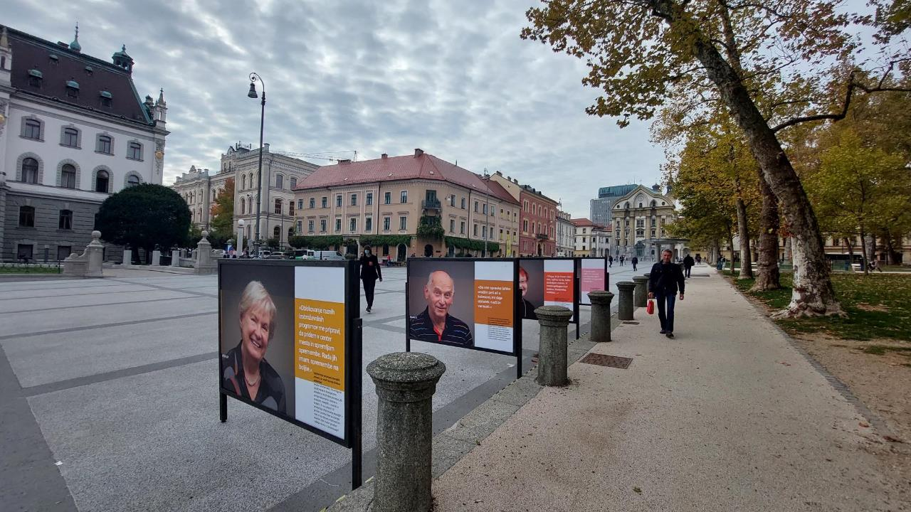
> Exhibition on one of the main squares in Ljubljana
Photo: U3A archive

Slide 11
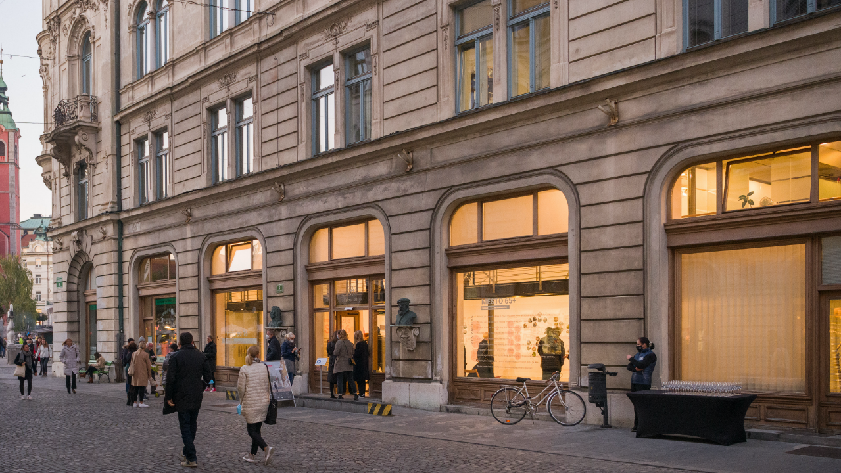
> Exhibition in Kresija Gallery, main gallery of the City of Ljubljana
Photo: Janez Marolt

Slide 12
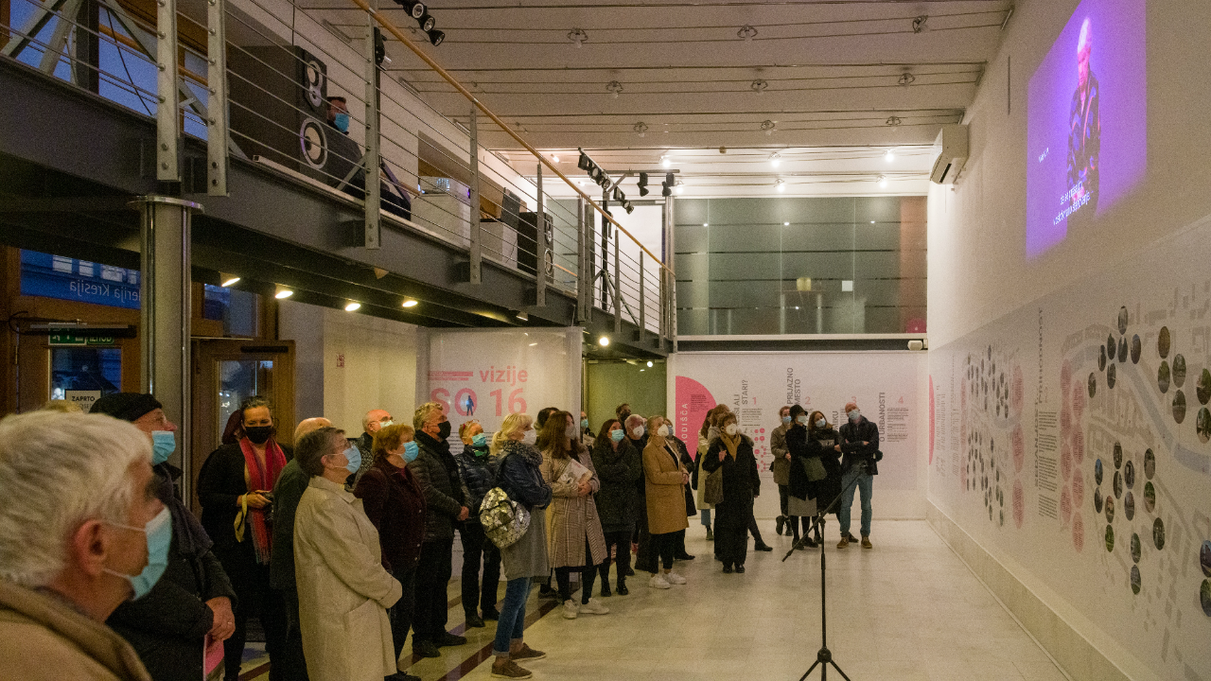
> Exhibition in Kresija Gallery
> Producing a film on the issues of public space of Ljubljana, scripted by older students
They used a knowledge they are gaining
Photo: Janez Marolt

Slide 13
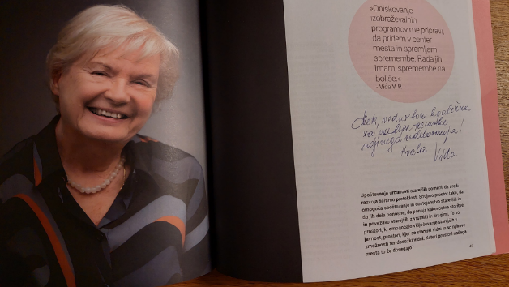
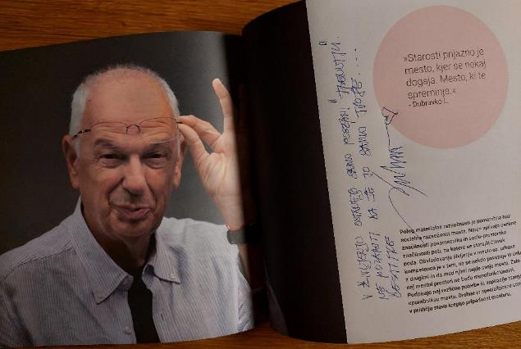
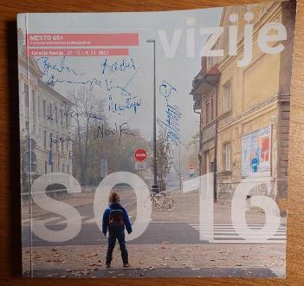
> Catalogue based on older people´s research findings
Photo: U3A archive
Photo: U3A archive

Slide 14
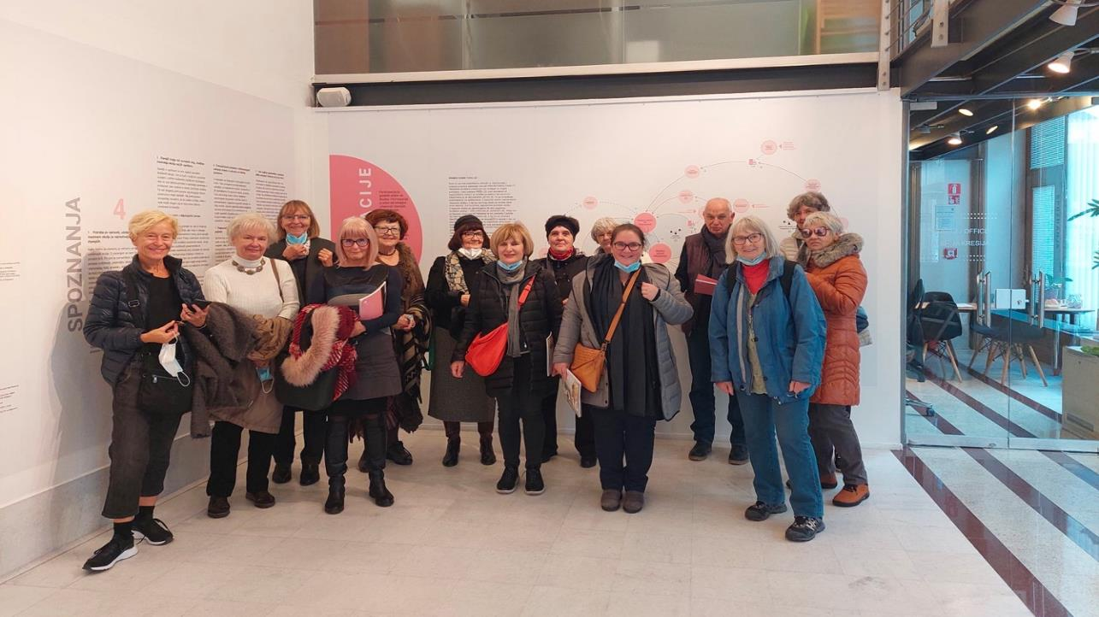
Their findings?
Photo: U3A archive

Slide 15
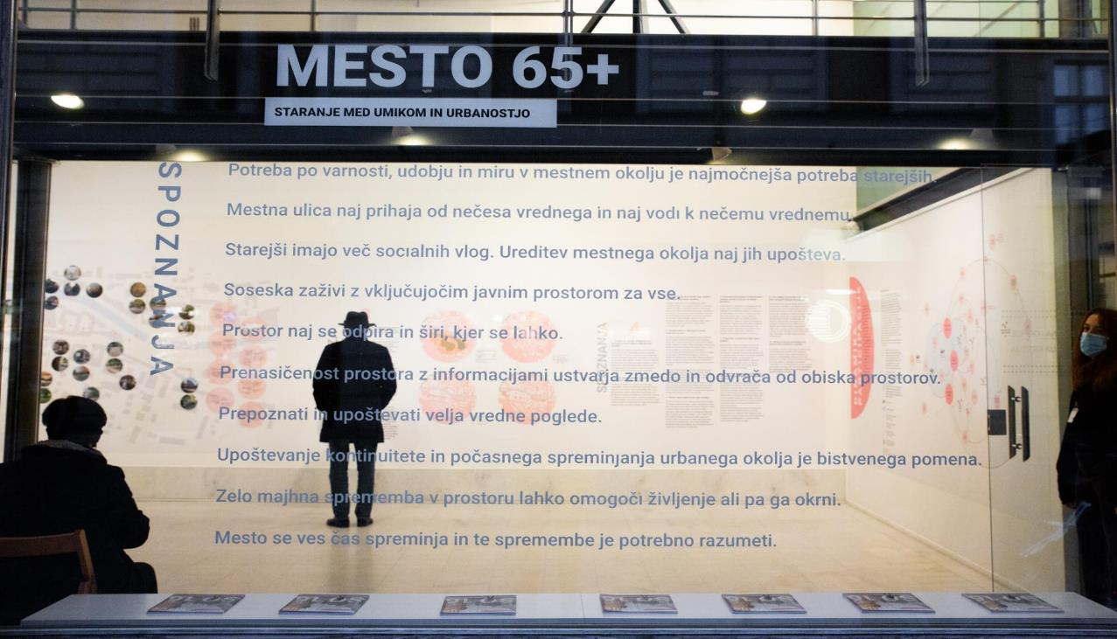
We bore in mind that older people should build a bridge to society:
we wrote their research findings on the display window of the gallery.
This was literally stepping out into public space
Photo: Kaja Brezočnik

Slide 16
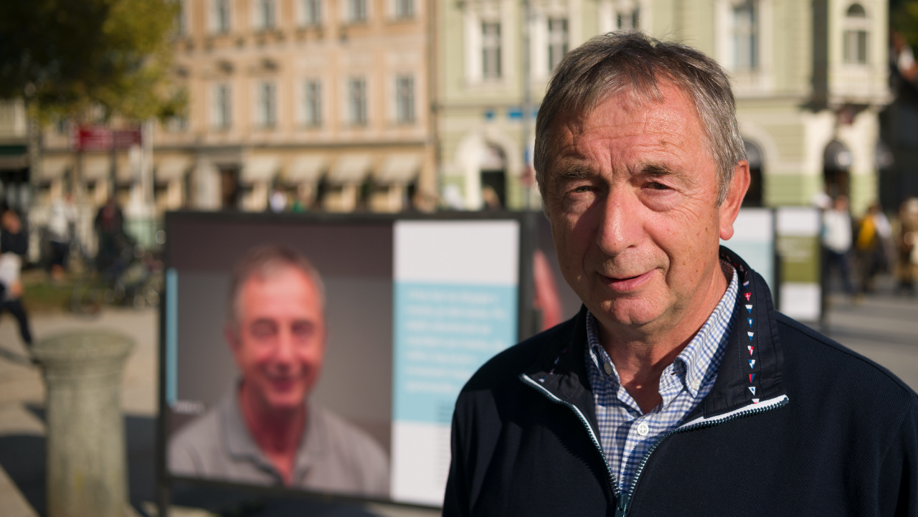
Stepping out into public space and raising awareness.
Photo: Janez Marolt

Slide 17
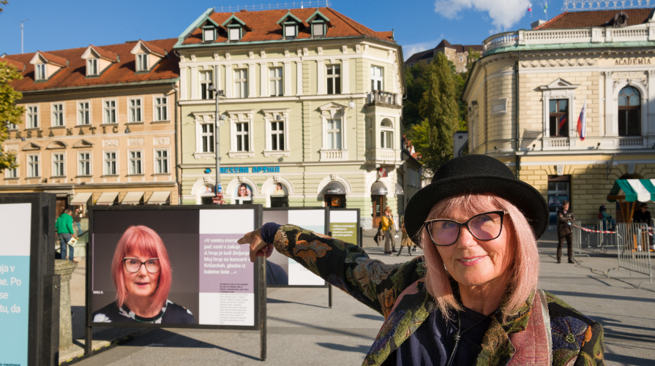
Photo: Janez Marolt
What for? They wanted to be seen, listened to, heard, understood, enriched
and be seen as achievers.

Slide 18
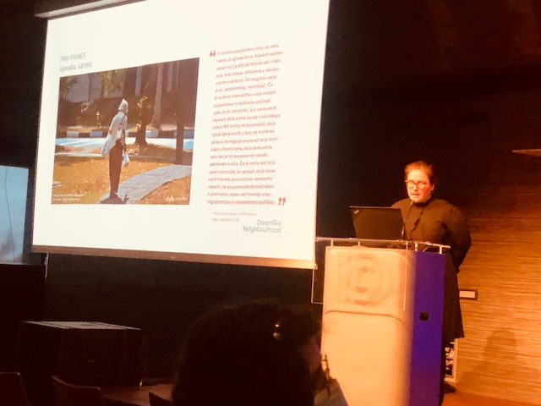
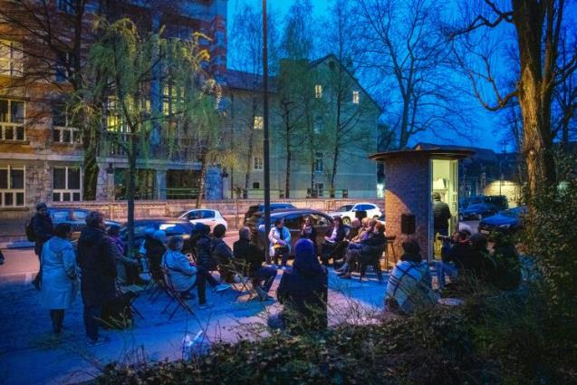
> Older people’s relationship with urban environment Center for Architecture Slovenia, Cankarjev dom, March 2022 Ministry of Culture, Ministry of Education, Science and Sport and National Education Institute Slovenia
Dissemination activities are a part of structured public campaining i.e.
a system of activities
Photo: U3A archive
> Dreamlike Neighbourhood International Street Event Outsider magazine Vegova street, April 2022
Photo: Janez Marolt

Slide 19
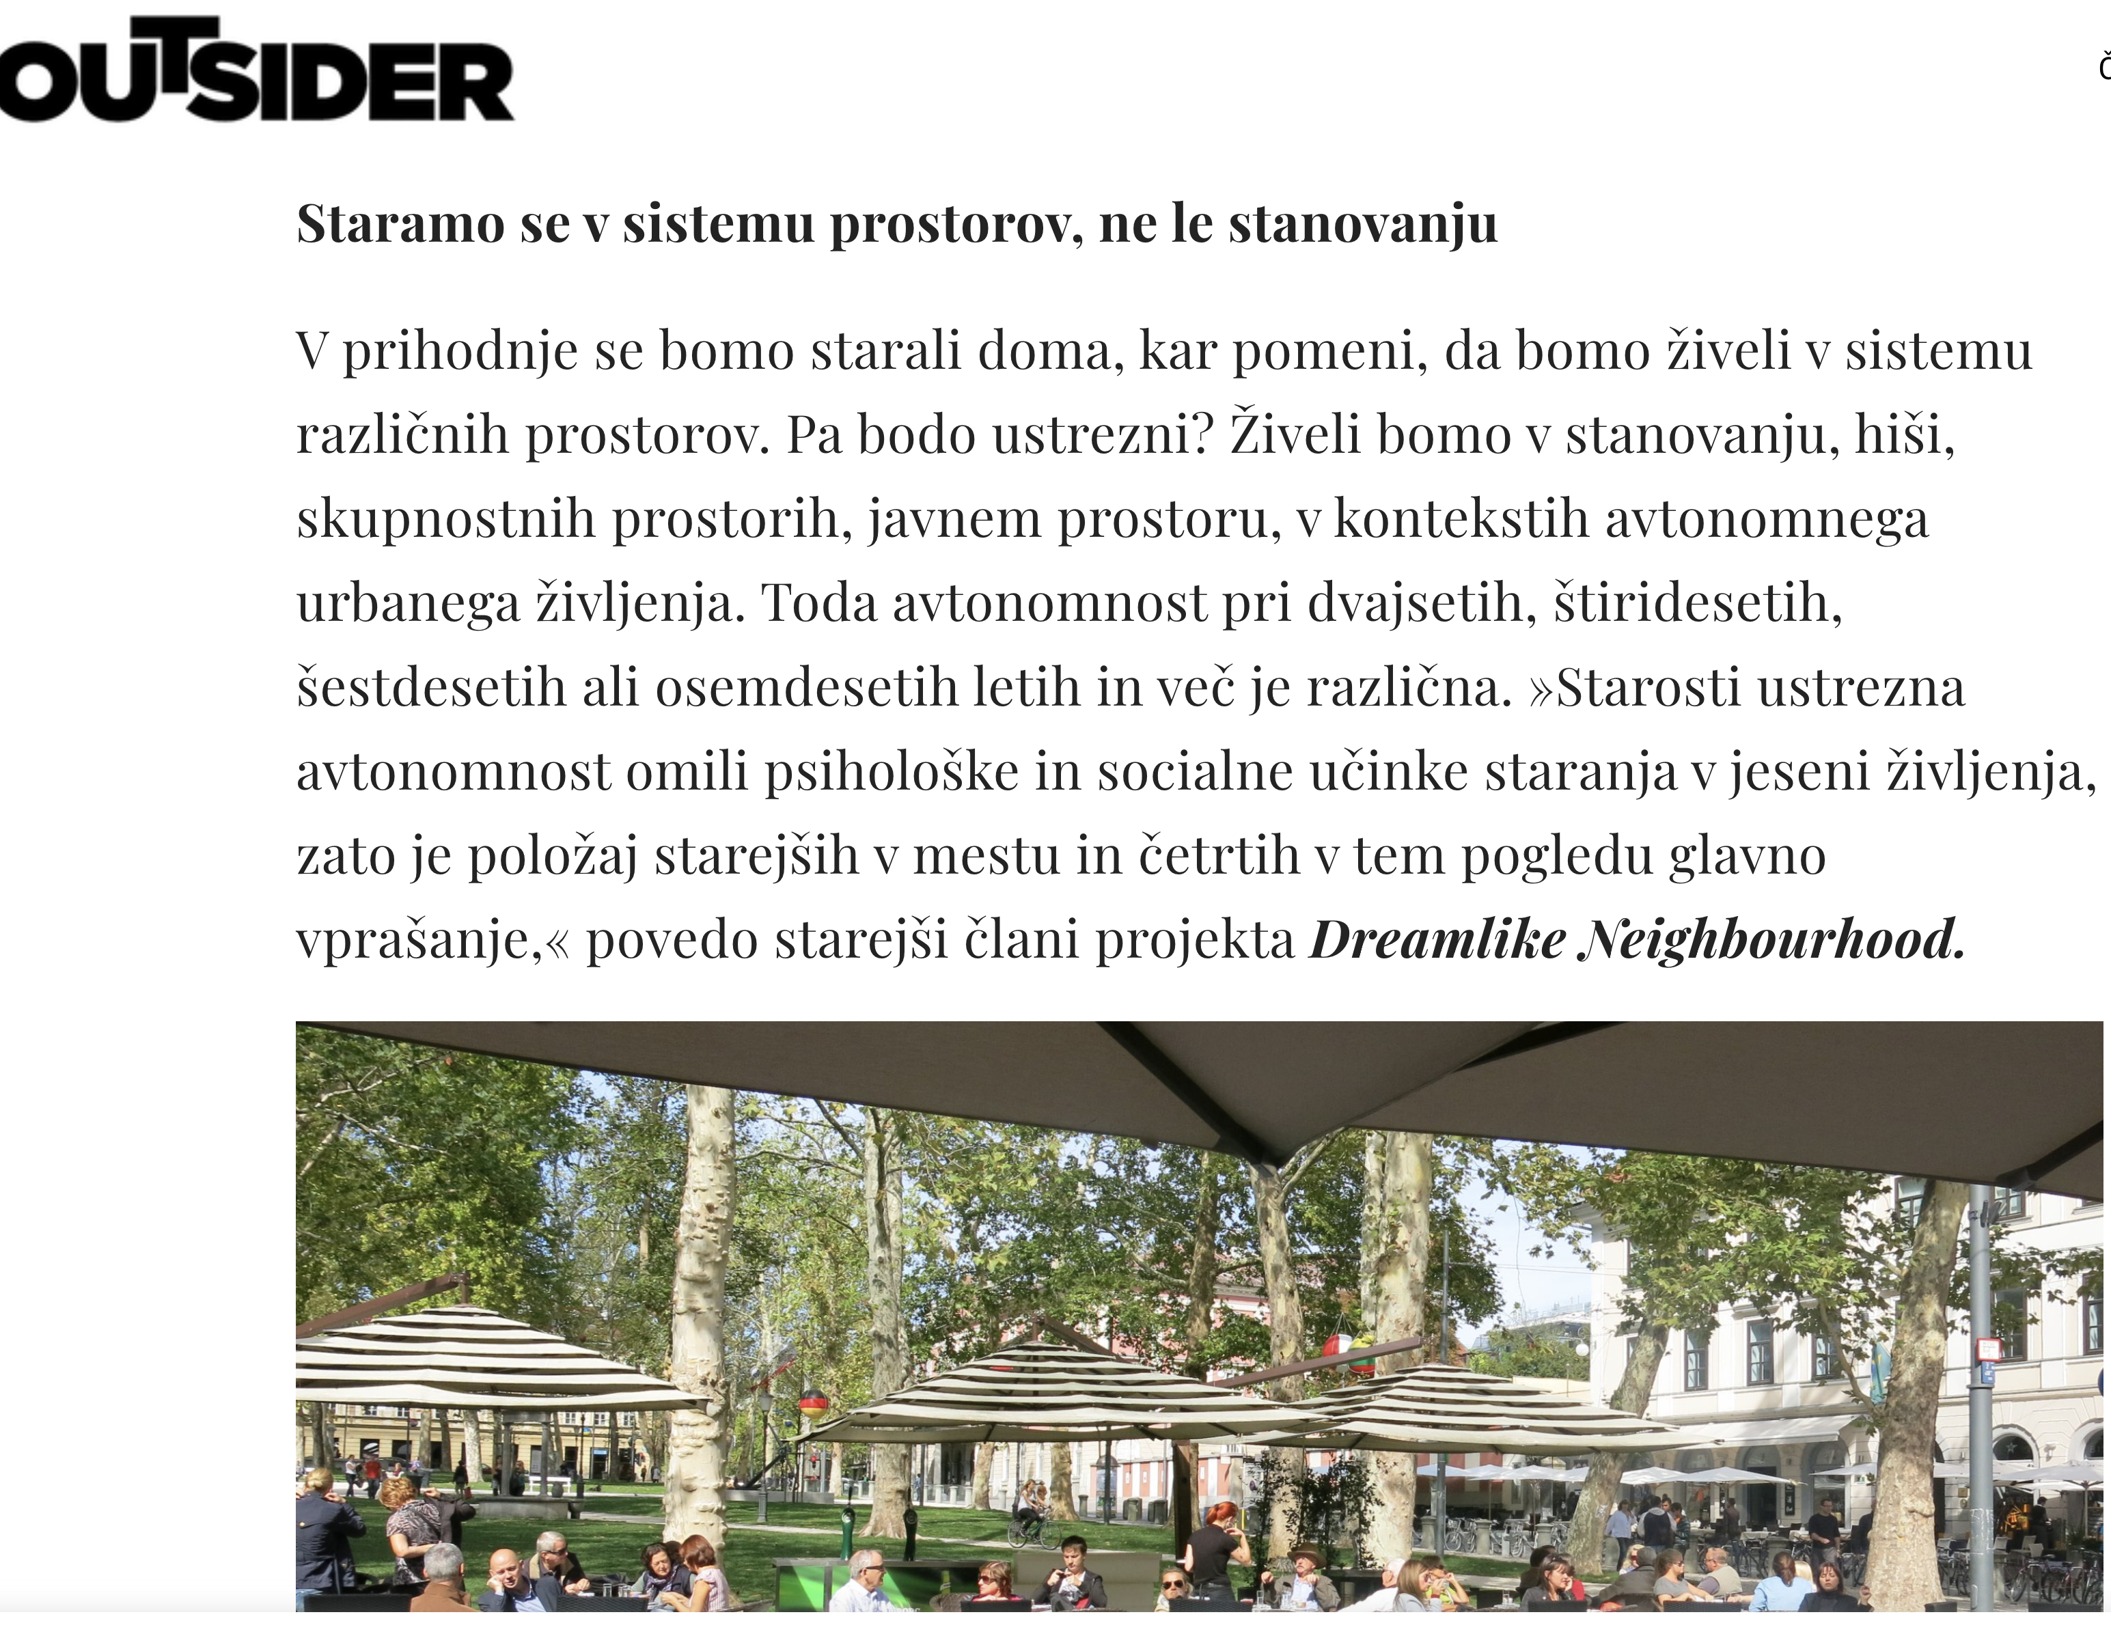
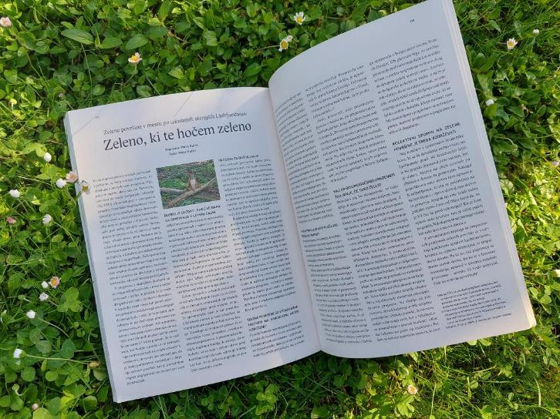
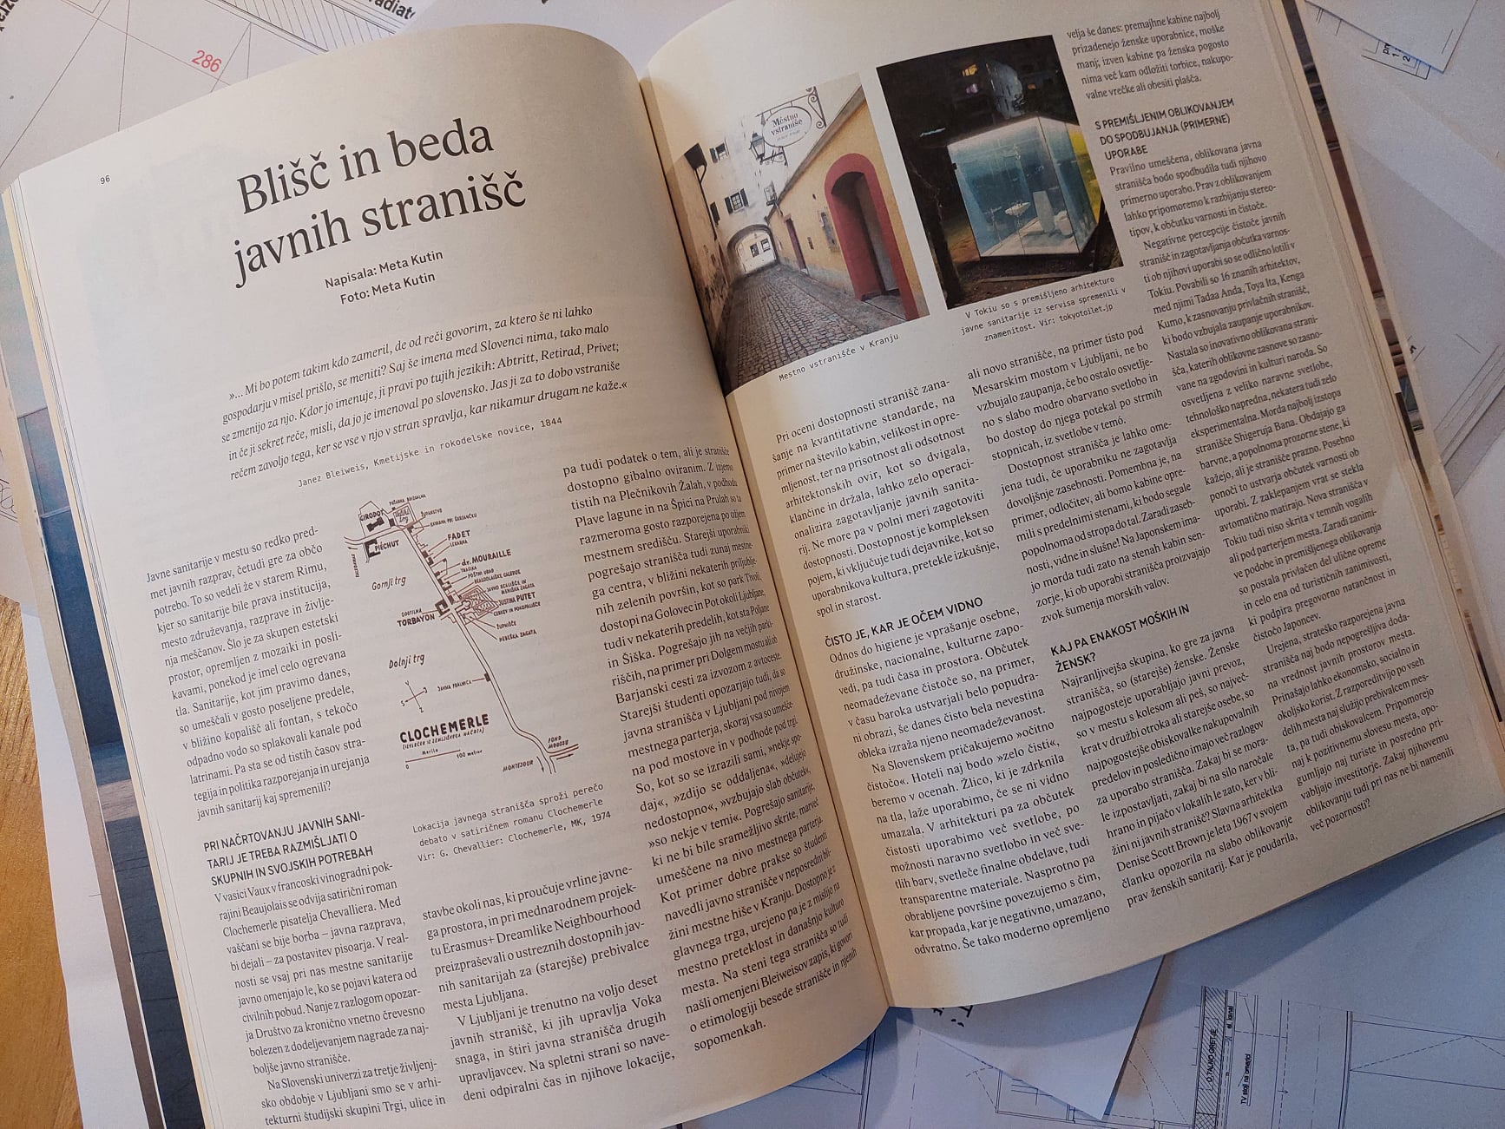
Fotos Study group
> Series of articles about their findings
Outsider magazine, 2022

Slide 20
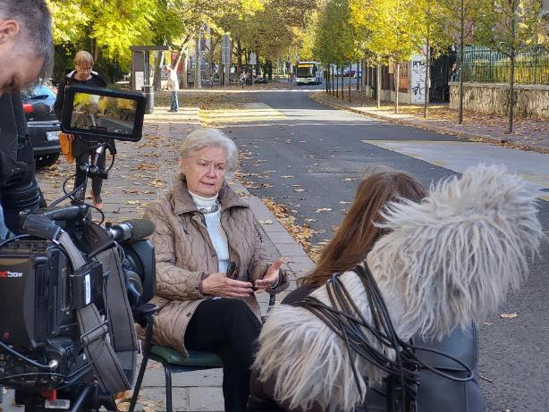
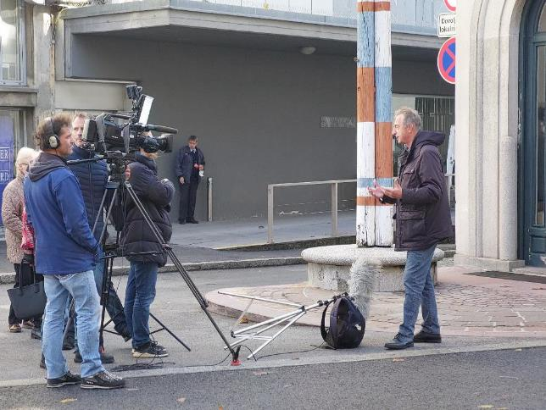
Photo: U3A archive
> Members of the Neighbourhood groups were invited to participate in a documentary progamme on the national TV channel. TV SLO, November 2021
Photo: U3A archive

Slide 21
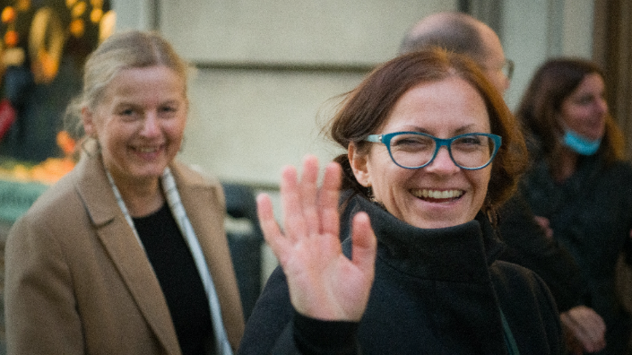
Why projects like Dreamlike Neighbourhood are needed? > to raise awareness of their presence, perspectives, beliefs, knowledge and research findings, > to aleviate stereotypes and prejudices about older people (words matter!), > to contribute knowledge about meaningful places and ageing in place, > to help architects and urbanists, policy makers, > to supplement the safe model of ageing by social and cultural ones.
Photo: Janez Marolt

