Slide 1
Dušana Findeisen,
Slovenian Third Age University
Intangible cultural heritage and your projects?
BBE
July 2018
ROGGENBURG

Slide 2
What comes to your mind when you hear
INTANGIBLE CULTURAL HERITAGE?

Slide 3
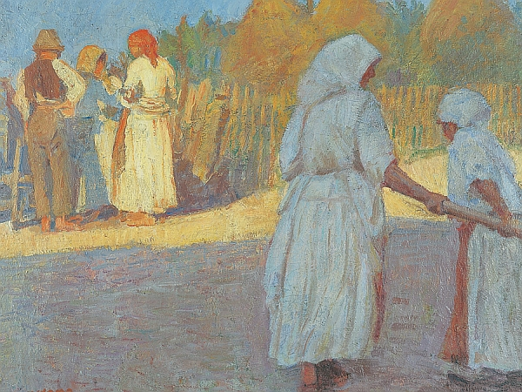
Culture? Art? Customs?

Slide 4
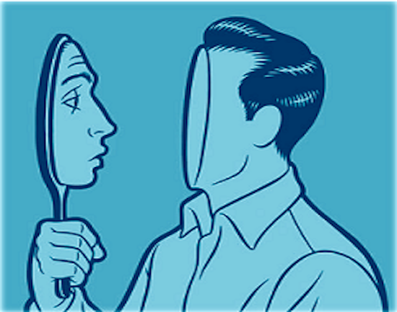
Identity?

Slide 5

Community?

Slide 6
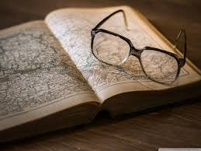
Knowledge, skills?

Slide 7
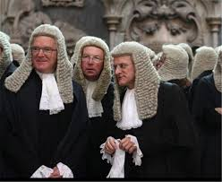
Tradition?

Slide 8
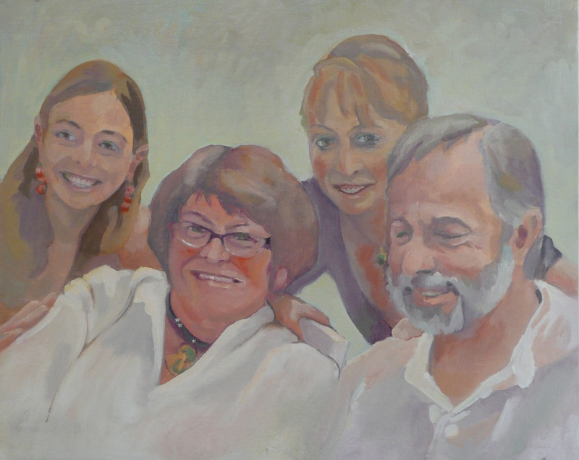
Family?

Slide 9
Memory?

Slide 10
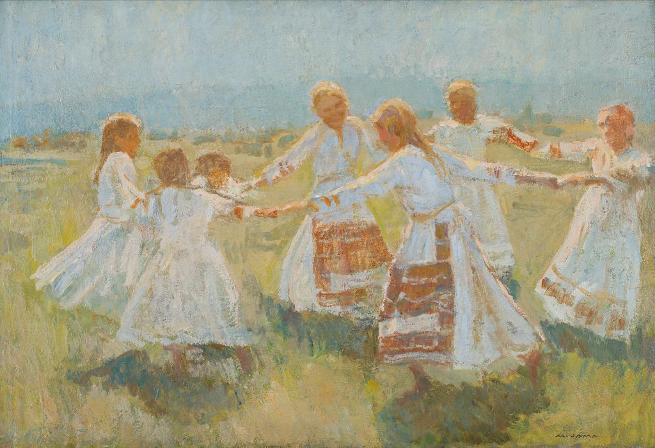
Folklore?

Slide 11
What comes to your mind when you hear CULTURAL HERITAGE
community?/
culture?/
tradition?/
skills?/
knowledge ?/
customs?/
ideas
family?/
memory?/
identity?,/
what relates to people? What connects/
alive?/

Slide 12
(1) What is cultural heritage?
CH becomes heritage if cultural + social values are attributed to it+ aesthetic appreciation.
Heritage is put under a lot of pressure-it should be better recognised and protected!
Idea of heritage is still drawing from the history of our world- heritage is mostly material (tangibile, material, monumental, grand of good asthetic value)
ICH is not easy to define; bcs it is intangible, live, evolving, focused on process: knowledge is less important than the process of getting it.
ICH is a living culture within cultural communities
ICH criteria; authenticity/community/testimony/characteristics/ danger of disappearing
Measures to empower the community?

