Slide 1
Dr. Dušana Findeisen
Slovenian Third Age University
There will be no Europe without culture... and digital awareness/consciousness
Prepared for Come together by culture
Ulm, 12th December 2023

Slide 2
STRUCTURE
(1) The changing European narratives and European awareness/ consciousness
(2) Culture and cultural heritage
(3) Digital consciousness /artificial intelligence as part of the European consciousness

Slide 3
(1) The changing European narratives and European awareness/ consciousness

Slide 4
European consciousness + digital consciousness are not formed from a single large bloc,
European consciousness has its distinctive forms:
! reflective European consciousness’.
European consciousness’ s related to European identity

Slide 5
European identity is not only about nostalgia of the urban Europe of the 19th century
Over 70 years narratives of European (collective) identity have been changing:
Belonging, inclusion, EU history
Knowledge, science
Norms, rights
Culture = + more resently digital awareness and connectivity.

Slide 6
The changing narratives of European identity/
Winston Churchil; European family=
Visionary+emotive quality narrative x remedy to economic disaster of the 2nd World War
60’s : by cold war-European identity was clearlyly felt
Common prosperity+ progress+common it was about EU’s past and future
EU= framework numerous transactions

Slide 7
Failures
Jacques Delors, Marcel Gauchet, Cohn Bendit and others:
Europe x political force x impose itself in globalisation processes but can be a moral force
Many documents have paved the way to artificial inteligence/digital consciousness
Lisbon Strategy
…EU to ‘become the most competitive and dynamic knowledge-based economy in the world capable of sustainable economic growth with more and better jobs and greater social cohesion

Slide 8
(2) Culture and cultural heritage

Slide 9
What comes to your mind when you hear culture or untangible cultural heritage?

Slide 10
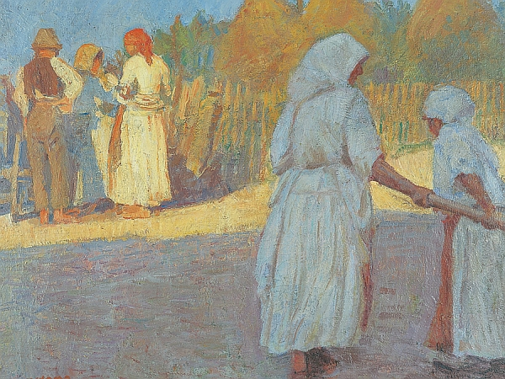
Culture? Art? Customs?

Slide 11
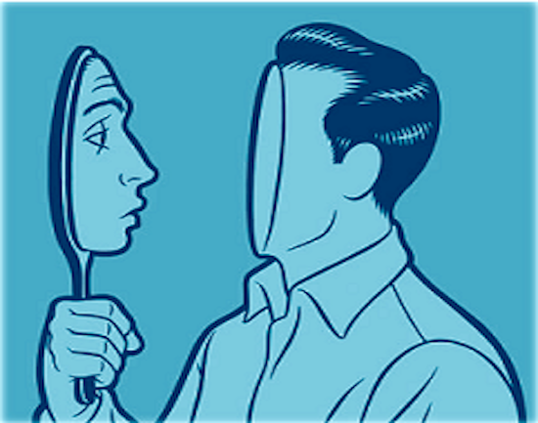
Identity?

Slide 12

Community?

Slide 13

Knowledge, skills?

Slide 14
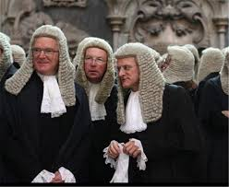
Tradition?

Slide 15
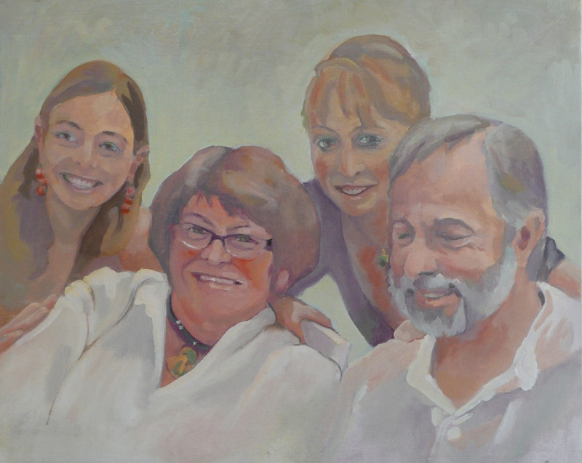
Family?

Slide 16
Memory?

Slide 17
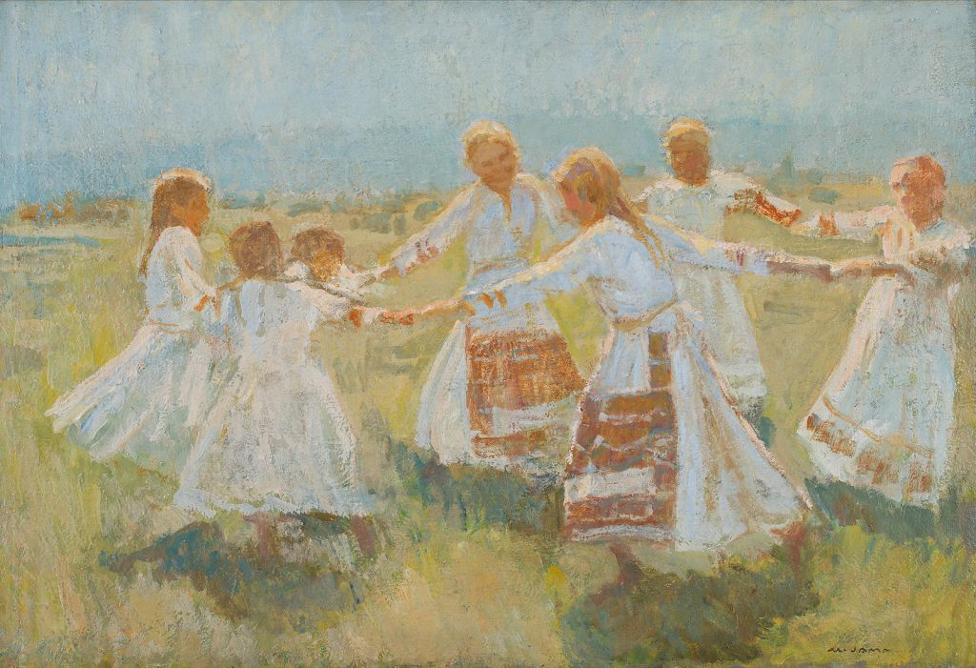
Folklore?

Slide 18
(1) What is culture/ cultural heritage?
Culture is everything that happens between one’s birth and death (Andre Malraux)
Cultural heritage is heritage if cultural + social values are attributed to it
+ aesthetic appreciation.
Heritage is put under a lot of pressure- it should be better recognised and protected! heritage is mostly tangible, material, monumental, grand of good aesthetic value
ICH is a living culture within cultural communities
ICH criteria; authenticity/community/testimony/characteristics/danger of disappearing

Slide 19
(3) Digital consciousness /artificial intelligence as part of the European consciousness

Slide 20
Artificial intelligence (AI) makes it possible -machines learn from experience, adjust to new inputs and perform human-like tasks.
AI examples today – chess-playing, self-driving cars –
Deeple translator, etc. rely on deep learning and natural language processing.

Slide 21
AI/ digital awareness/digital consciousness is at the heart of the 4th Industrial revolution 4.0 ( word coined in 2008)
Today three worlds are colliding together: digital (internet, social networks etc.) virtual (augmented reality: in education, medicine etc.) physical world
We have been facing/will be facing a radical change (consumption, production, interaction)
But! At the core of everything is the human being
(Henrik von Scheel)

Slide 22
Anxities related to AI
Global competition
Job market transformation
Change of social policies
Negative impact on rights and freedoms
"Europe Fit for the Digital Age” is a political priority- EU Commission= responsible for devpt of AI policy- a result of many initiatives like Digital education action plan, skills agenda, digital literacy + competences at all levels of education….

Slide 23
European Commission + the European Parliament, consultative committees etc. have defined a common strategy in relation to AI.
There will be public funding of research, public investment, and regulations for industry.

Slide 24
In December 2023 the EU Parliament and Council have reached a provisional agreement on the Artificial Intelligence Act.
This regulation aims to ensure that rights, democracy, the rule of law and environmental sustainability are protected from high risk AI,
+ innovation and making Europe a leader in the field. The rules establish obligations for AI based on its potential risks and level of impact.

